Slide 1

GO Team Meeting #1
West Manor Elementary

Slide 2
Agenda
School Strategic Plan
Strategic Plan & Priorities Review
SMART Goals
Data Discussion
Spring MAPS and GMAS
Stakeholder Engagement At Our School
Principal’s Report
Current Enrollment & Leveling
Information about our school
APS Forward 2040: Comprehensive Long-Range Facilities Plan

Slide 3
2021-2025
Strategic Plan

Slide 4
West Manor IB World School
SMART Goals
Increase the % of grades 3-5 students scoring proficient or above on Milestones/ MAP in reading by 3%
Increase the % of grades 3-5 students scoring proficient or above on Milestones/MAP in math by 3%
Increase the percentage of students with 10 or less absences by 3%
APS Strategic Priorities & Initiatives
School Strategic Priorities
School Strategies
Fostering Academic Excellence for All
Data
Curriculum & Instruction
Signature Program
1.
3.
1A. Implementation of an intervention block to reduce gaps in learning
1B. Employ a literacy block with phonics for grades k-2
1C. Create PLC planning time for teachers to internalize standards and plan for instruction
Increase student phonic awareness and create early readers
Increase student knowledge in numbers and operations domain
Increase student multiplication skills
Building a Culture of Student Support
Whole Child & Intervention
Personalized Learning
Increase student attendance and decrease suspension rate
TBD: Create an attendance team to monitor and address attendance concerns, Create a Care Team to address student needs
TBD: Utilize SLC practices and restorative justice with the Counselor to reduce suspensions
Equipping & Empowering Leaders & Staff
Strategic Staff Support
Equitable Resource Allocation
Increasing Teacher knowledge of Standards
Increase Teacher knowledge of IB Program
TBD: Monthly IB training for staff, Professional development individualized around teacher needs in reading and math, training for phonics program (Fundations)
Ongoing PD for SEL, restorative practices, and trauma
Creating a System of School Support
Collective Action, Engagement & Empowerment
TBD: Conduct data meetings in PLC, with parents and students. Students will also have goal setting meetings with teachers
--Increase Parent Liaison and Social Worker positions to full time to support the needs of students and parents
Improve stakeholder knowledge of school data and how to assist
Provide support to students and stakeholders in need

Slide 5
Strategic Plan
Priority Ranking
Insert the school’s priorities from Higher to Lower
Higher
1.Increase student phonic awareness and create early readers
2 Increase student knowledge in numbers and operations domain
3. Increase student multiplication skills
4. Increase student attendance and decrease suspension rate
5.Increasing Teacher knowledge of Standards
6.Increase Teacher knowledge of IB Program
7. Improve stakeholder knowledge of school data and how to assist
8. Provide support to students and stakeholders in need
Lower

Slide 6
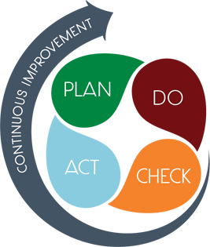
Connecting the
Strategic plan &
Continuous Improvement Plan
1.Increase student phonic awareness and create early readers
Increase student proficiency on ELA assessments by 3%
Milestones and MAP Scores
2. Increase student knowledge of new math standards
Increase student proficiency on Math assessments by 3%
Milestones and MAP Scores
Improve student attendance
Increase average attendance rate from 95% to96%
CCRPI Attendance Rate

Slide 7
Data
Discussion

Slide 8
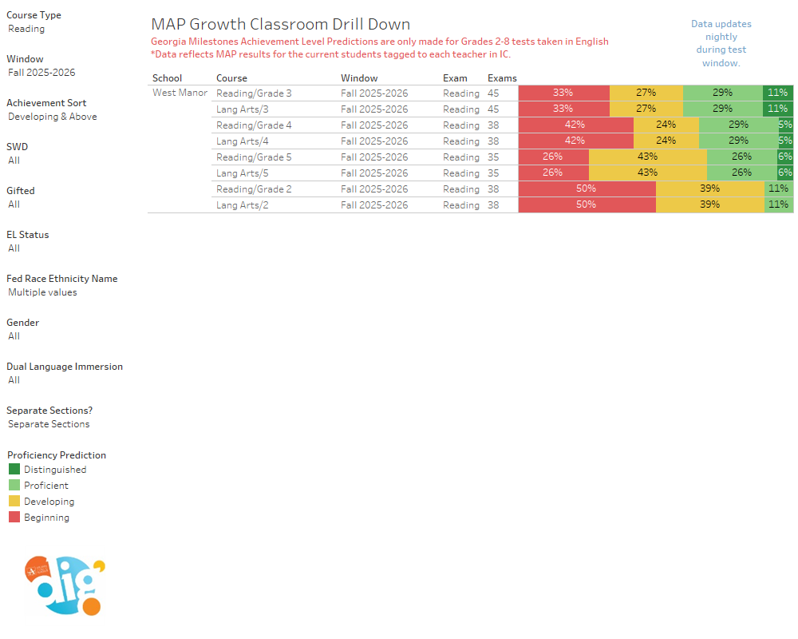
Spring MAP Results

Slide 9
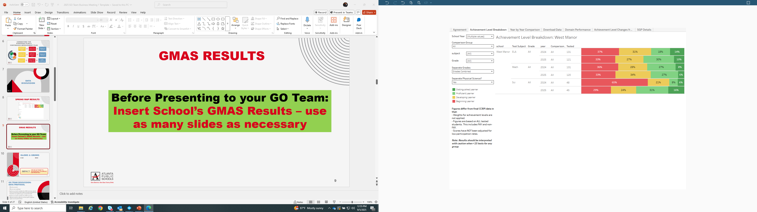
GMAS Results

Slide 10
Glows & Grows
ELA/Reading
Overall proficiency is 39.7%, with a +7.6-point gain from 2024.
3rd grade showed exceptional growth (+27.1 pts), reaching 41.0% proficiency.
5th grade also made strong gains (+9.2 pts to 46.7%).
4th grade declined significantly by -10.7 pts to 29.7%
Math
Overall Math proficiency is 32.5%.
5th grade was a bright spot with +19.4 pts (now at 44.4%).
4th grade experienced a dramatic drop of -33.7 pts (now 19.4%), representing a major outlier.
3rd grade held steady with a slight increase of +3.0 pts
Science
Science proficiency rose to 46.7%, with a substantial +32.1-point gain, primarily driven by improvements in 5th grade performance West Manor Embargoed Mi….
are we on target to successfully ACCOMPLISH our priorities?
IMPACT

Slide 11
Glows & Grows
Bright Spots by Student Group
Hispanic students excelled in ELA with a +13.7-point increase, reaching 47.1% proficiency.
Black and ED students showed major gains in Science:
Black students: +33.5 pts (48.5% proficient)
ED students: +32.1 pts (46.7% proficient)
Nearly all student groups demonstrated improvement in ELA, with the exception of EL students
Declines to Monitor
Hispanic students saw a sharp decline in Math (-25.5 pts).
SWD students continue to struggle with very low performance in both ELA (11.1%) and Math (11.1%), despite a slight ELA gain.
EL students declined in ELA (-6.4) and performed below average in Math (33.3%).
ED students showed no ELA growth and a -3.4 pt drop in Math
are we on target to successfully ACCOMPLISH our priorities?
IMPACT

Slide 12
GO Team Discussion:
Data Protocol
What do you notice?
What are your wonderings?
Based on our school’s trend data from MAP assessments and end-of-year test assessments, which student sub-groups and grade levels showed the most significant gaps or unexpected trends?
Based on our school’s trend data from MAP assessments, Milestones and other indicators, are there specific trends that require more focused attention?
What additional questions do you have?

Slide 13
Timeline for GO Teams
You are HERE
Fall 2021
GO Team Developed 2021-2025 Strategic Plan
1
Summer
School Leadership completed Needs Assessment and defined overarching needs
2
August
School Leadership completed Continuous Improvement Plan
3
Sept. – Dec.
GO Team reviews progress on current strategic plan.
GO Team develops 2025-2030 School Strategic Plan
4
Before Winter Break
GO Team will take action (vote) on the rank of the strategic plan priorities for SY26-27 in preparation for budget discussions.
5

Slide 14
Questions?

Slide 15



Why We’re Here
GO Teams play a vital role in decision-making that impacts the school’s direction, priorities, and overall success.
Stakeholder engagement ensures that the decisions we make reflect the real needs and voices of the people our schools serve.
We’re stronger when we bring others into the work—when we listen, learn, and co-create with families, students, staff, and community members.
Today our GO Team will: Brainstorm ways to involve our school’s key stakeholders in our work.
Stakeholder
Engagement
At Our School
Notes:
Next, we’re going to discuss stakeholder engagement. As a charter system, the decisions the GO Team makes shapes our school’s future — and the best decisions come from hearing the diverse voices within our school community..
When we bring families, students, staff, and our community into the work—not just into the audience—we get stronger ideas, better outcomes, and a shared vision we can all stand behind.

Slide 16
Here’s the challenge:
We’re going to look at four groups—Families, Students, Staff, and Community.
For each group, we’ll ask and answer three questions:
INFORM – What’s a fun or unexpected way to keep them in the loop?
INPUT – What’s a meaningful way to get their ideas or feedback?
INVITE – How can we bring them into the work, not just the audience?
Let’s get creative, specific, and push past the usual answers.
Stakeholder
Engagement
Exercise
Notes:
Here’s the challenge: We’re going to look at four groups—Families, Students, Staff, and Community.
For each one, we’ll answer three questions:
INFORM – What’s a fun or unexpected way to keep them in the loop?
INPUT – What’s a meaningful way to get their ideas or feedback?
INVITE – How can we bring them into the work, not just the audience?
Let’s get creative, get specific, and push past the usual answers.

Slide 17

 | FAMILIES | STUDENTS | STAFF | COMMUNITY
INFORM What’s a fun, unexpected way to keep them in the loop?
INPUT What’s a meaningful way to gather their ideas or feedback?
INVITE How can we bring them into the work, not just the audience?
Notes:
Here’s the challenge: We’re going to look at four groups—Families, Students, Staff, and Community.
For each one, we’ll answer three questions:
INFORM – What’s a fun or unexpected way to keep them in the loop?
INPUT – What’s a meaningful way to get their ideas or feedback?
INVITE – How can we bring them into the work, not just the audience?
Let’s get creative, get specific, and push past the usual answers

Slide 18
Principal’s Report

Slide 19

(West Manor)
LEVELING AND
FY26 BUDGET ADJUSTMENT
Template Last Revised: 9/4/2025

Slide 20

Enrollment
Projected Enrollment | 252
15-Day Count(08.22.25) Enrollment | 238
Difference | 14
Budget Adjustment* | $83468
*The budget adjustment reflects the impact of the following: Enrollment changes, school reserves, Title I Part A, Title I- Family Engagement
Hold harmless
To support academic stability in schools, budgets were not reduced beyond school reserves.
Notes:
Principals: Based on your15-Day count, please give your GO Team an overview of your projected vs. 8/22 enrolled numbers as well as information on your FY26 budget adjustment.

Slide 21
Summary of Changes as a Result of FY26 Budget Adjustment
Personnel Changes | Non-Personnel Changes
None | No additional resources will be purchased
Summary of Changes
PRINCIPALS: Please provide a summary of the impact these changes and how it relates to your strategic plan here.

Slide 22


APS Forward 2040:
Reshaping the Future of Education
Taskforce Meetings
May 8, 2025 - Presentation
August 5, 2025- Presentation
Upcoming Public Meetings
October 20
November 10
Virtual – at Noon
In-person at 6PM at CLL (130 Trinity Ave)
UPDATE
Comprehensive Long-Range Facilities Plan
atlantapublicschools.us/APS2040
Notes:
Next on our agenda, we’d like to welcome our representative to the Long-Range Comprehensive Facilities Master Plan Taskforce. As many of you know, this taskforce plays a key role in shaping the future of our district’s facilities — ensuring they are aligned with projected enrollment, instructional needs, safety standards, and long-term community use."
Over the summer, the taskforce has been hard at work reviewing data, exploring options, and engaging in important planning conversations. [Name of Representative] will share an update on what’s been done so far, any key decisions or recommendations that have been made, and what’s ahead — including opportunities for the public to provide input.
[Allow the FMP representative to provide an update and answers questions. After this is concluded:]
Thank you [Name of Representative].
A report will be presented to the Board at its August 11 meeting, and the options will become public the week of August 18.
There are several upcoming public meetings where you can learn more and share your thoughts. The next public meetings are scheduled for: August 25, October 20, and November 10
On each date, there will be a virtual meeting at noon and an in-person meeting at the Central Office at 6PM.
I strongly encourage you all to attend these meetings. This is a critical time for public input, and your voice is essential.

Slide 23
SAVE THE DATE
IN-PERSON
Bring the full GO Team
Come ready to collaborate, contribute, and create the future!
G3 Summit
Go.Grow.Govern.
Come learn more about:
Your school’s 2025-2030 Strategic Plan
Stakeholder Engagement
APS Forward 2040
…and much more
Saturday
September 27
8:30 AM – 2:30 PM
Notes:
Before we move on, I want to highlight an important upcoming event: the G3 Summit on Saturday, September 27.
We need as many GO Team members as possible to attend — this is a critical opportunity to come together, in person, and shape the future of our schools. Strategic planning for 2025–2030 is underway, and your voices, ideas, and leadership are essential.
You’ll be learning about your school’s new strategic plan, best practices for stakeholder engagement, and how this work connects to APS Forward 2040 — plus much more.
Please save the date and plan to attend! Come ready to collaborate, contribute, and create the future together.
More information will be coming soon.

Slide 24
Questions?

